Slide 1


JUMPSTART & JUNIOR PARENT MEETING

Slide 2
Welcome to Starskate! Jumpstart and Junior Programming
Your skaters are currently on the Starskate Pathway in the learn-to-train level as part of the Sport for Life’s Long-term development
When logged into your account with Skate Canada you can read more on the Starskate Pathway
Go to skatecanada.ca/members to create an account in your child’s name. This way you will be able to see their STARskate Achievements and follow their official progress.

Slide 3
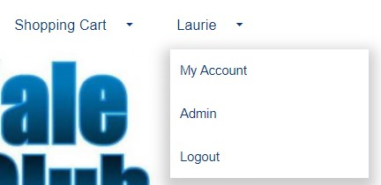
REMINDER: Your Account
Click on the drop down that reads “My Account”
Once in your account you can access your profiles
Update Contact Information
Review your participants and their evaluations or achievements
THE CALENDAR TAB while logged into your account shows all your registered skating times and events.
Invoice Tab for copies of all your registrations

Slide 4
City Subsidy
The club will need to confirm addresses of those that qualify for the city subsidy.
The subsidy covers the balance set program cost
Paying a subsidy non-qualifier fee
This amount is the same amount as what the city pays for those within their city limits
Where to address concerns

Slide 5

STORM WATCHES AND CLOSURES – in the event of storms or unforeseen closures, we will post on our website as well as send you an email. We normally only close if the facility is closed. Therefor if you see from a community posting that the arena is closed, then so are we. There is the off-chance if our administrator does not have power, they will not be able to email you. Please don’t call the arena as they are not part of our operation for detailed info.
Please keep your account contact info up to date. You can add a second email to your account if needed

Slide 6
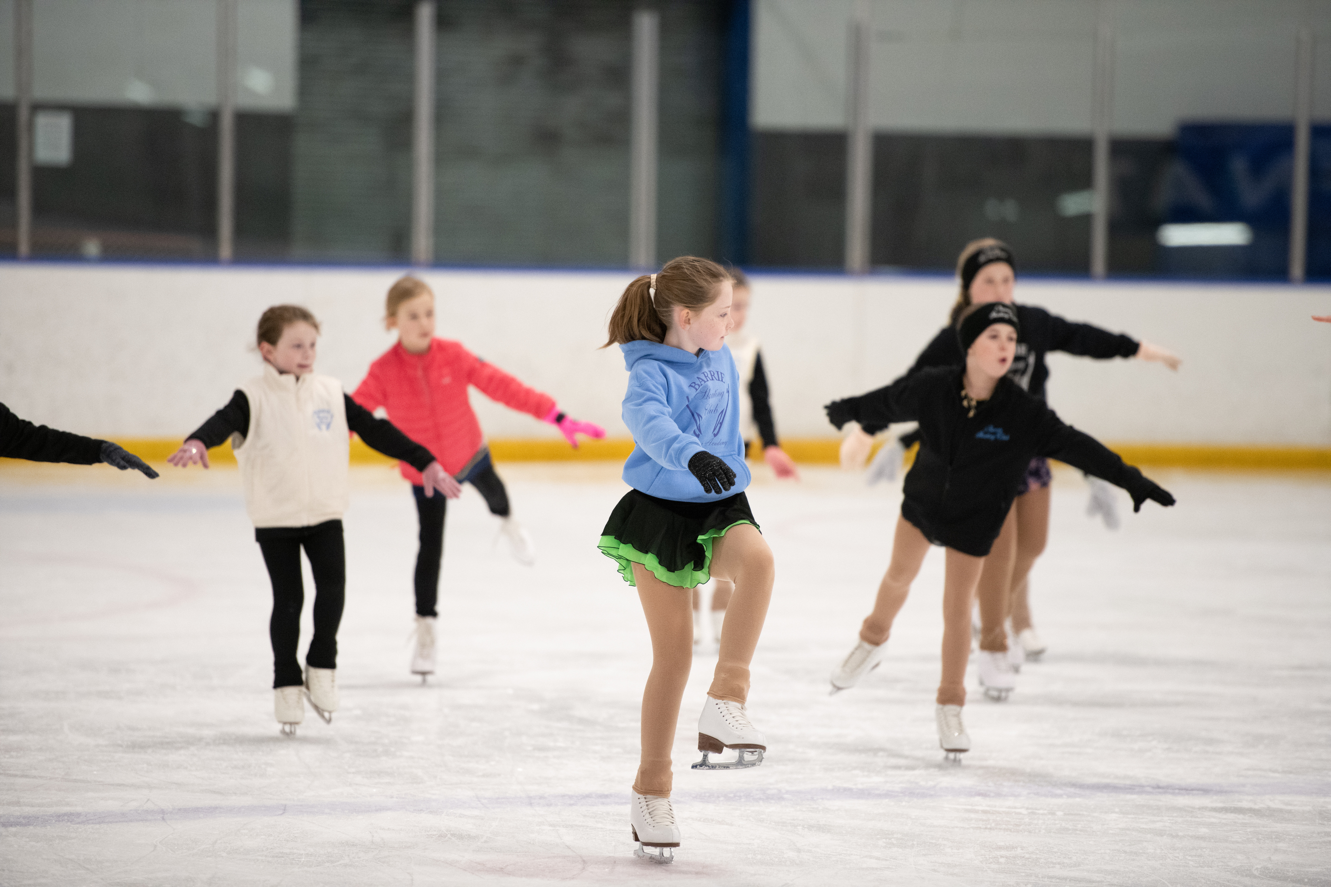
Program Specifics
Jumpstart
Fast Track to figure skating
100% group lesson time
Share the ice with Juniors
Juniors
Star 1 & 2 levels or with coach recommendation
¾ of the time is Group Lesson Time
¼ is self practice with supervision; important part of development
Shared Ice with either Jumpstart or Intermediate/Seniors
Private Lesson Options

Slide 7
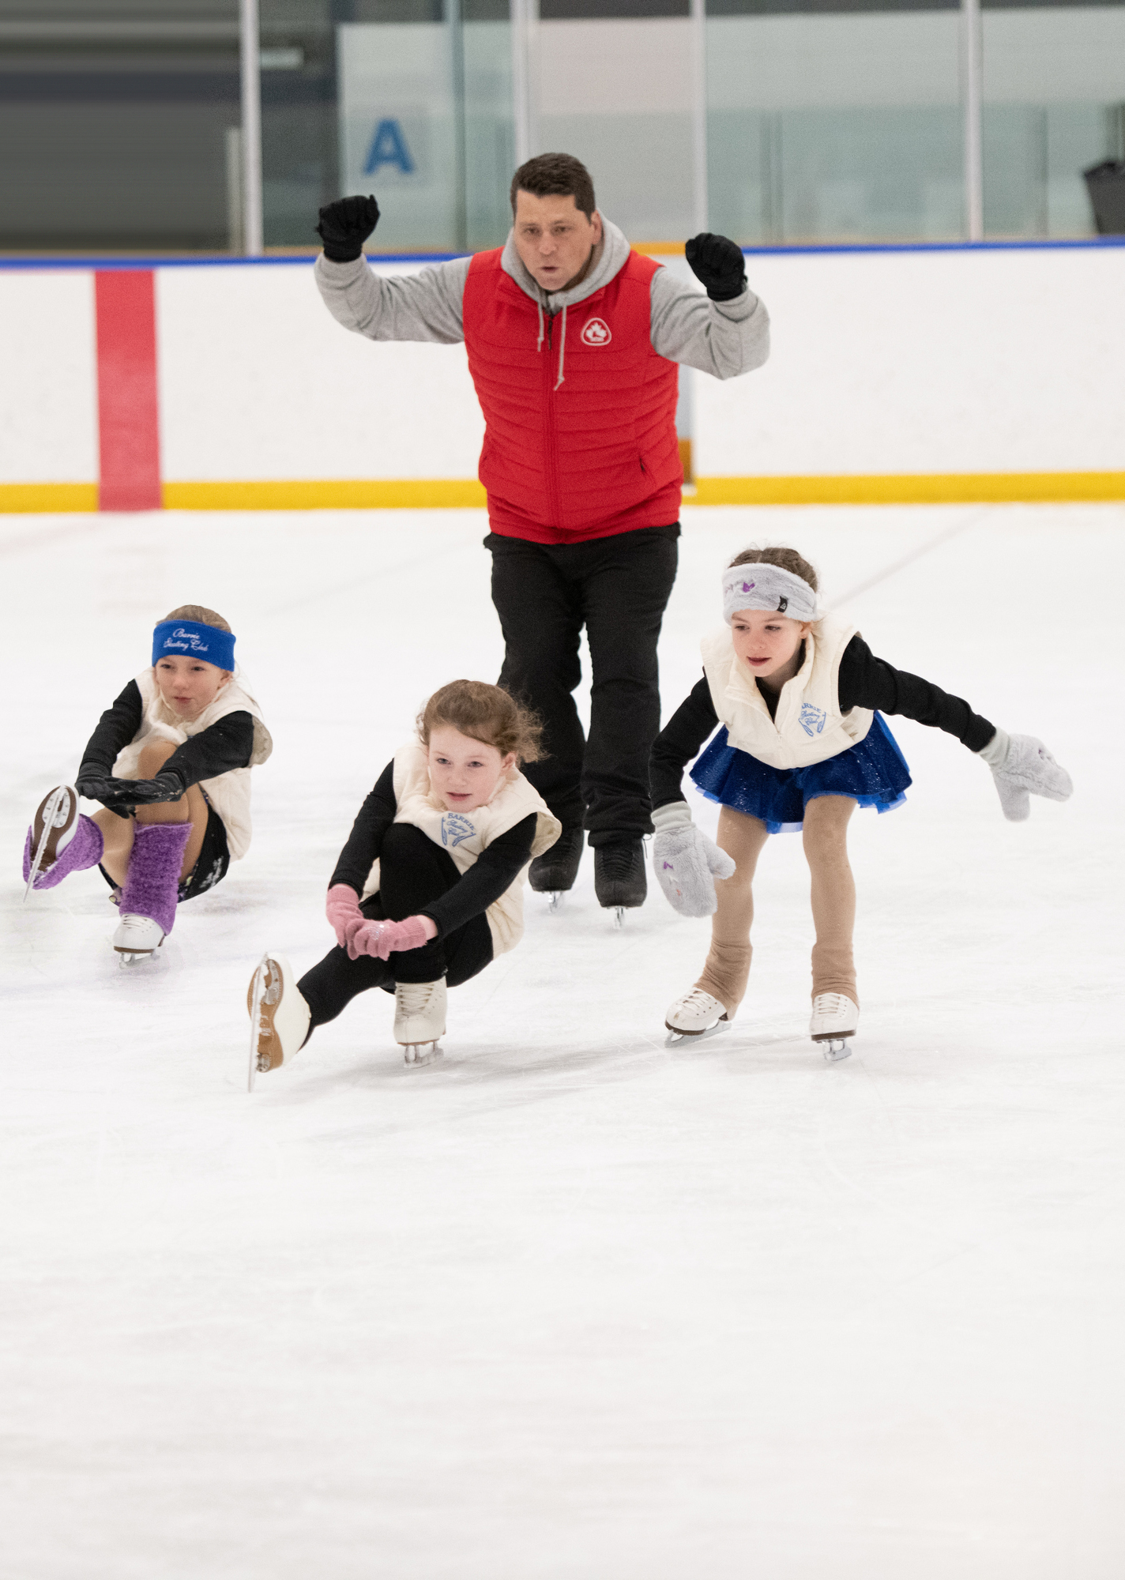
Assessments
Skaters at the Jumpstart level will complete their Canskate Badges while learning to figure skate. These are listed under achievements at the club level on our website.
Junior Skaters will start or be working on Star 1 – 2 assessments in dance, skills and freeskate. It takes a lot of practice to accomplish the skills in each area.
The Starskate assessments cost $12 per assessment which goes to Skate Canada. Any additional fees are covered by the Admin Fee you paid on registration.
Coaches will provide you with an envelope and instructions for returning once your skater is ready to take an assessment.
You need to purchase the assessment on-line and include the name of the tests in the comment section of your invoice – this is your receipt. If paying by cash -Choose e-transfer when creating your invoice. Include your invoice number on your envelope.

Slide 8
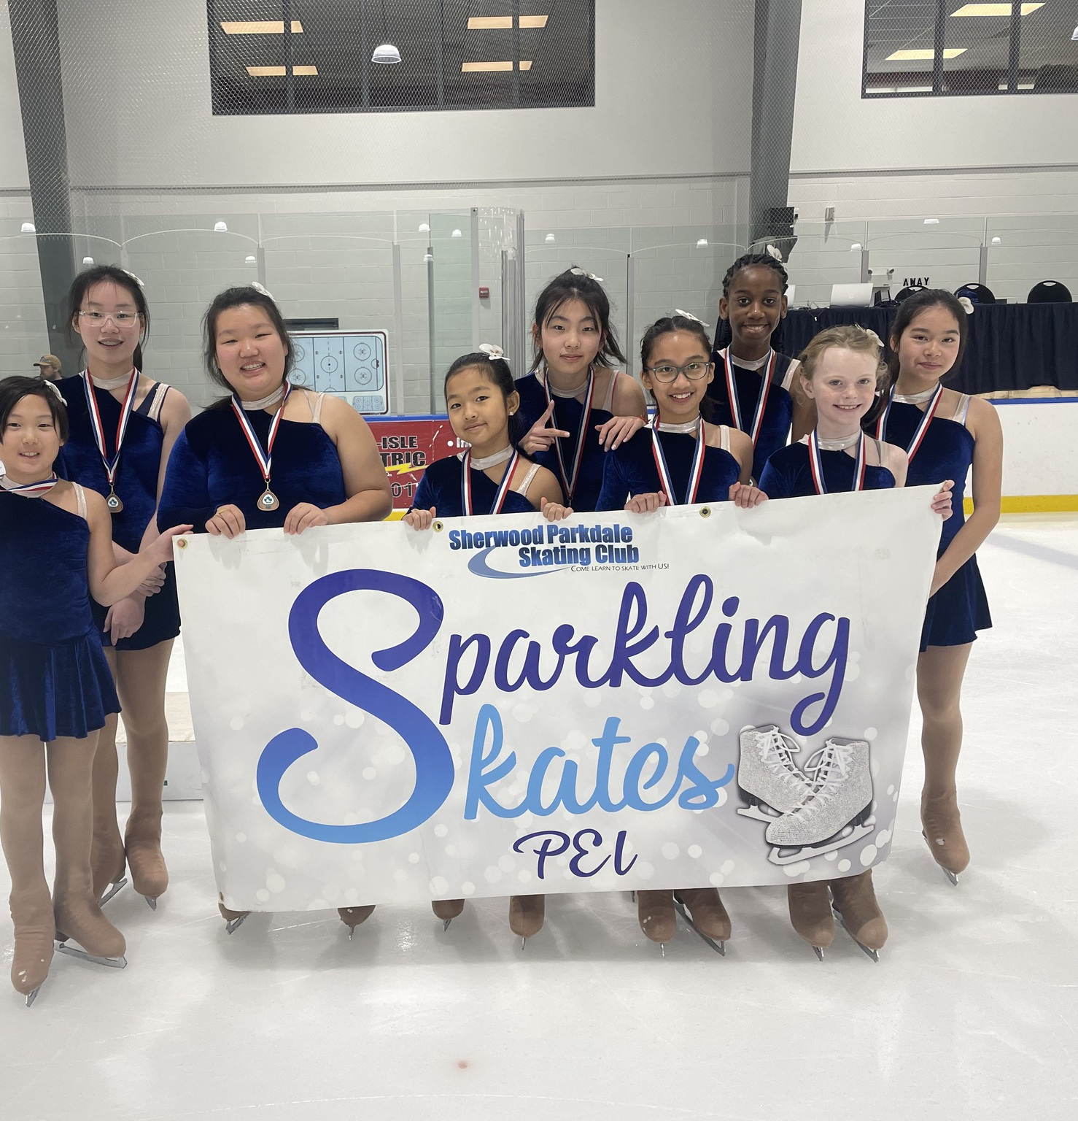
Synchro
All STARSkaters are encouraged to take part in Synchro
As part of the Skate Canada curriculum, this session is an excellent opportunity to develop skating skills in a fun and supportive atmosphere.
For the skaters, this is a great opportunity to engage in a team environment which complements personal skills learned as a singles figure skater.
The cost is $150 ($25 installments/month) as an add-on to a Starskate Registration .
Synchro includes ice time, coaching, off-ice classes, the Team portion of competition registration fees
New team members will also receive a free Sychro Jacket

Slide 9
Events
JUMPSTARTS
Can register for our club “Canskate Merit Event”
As part of Skate Canada’s long-term-development, these type of events get your skater ready for the learn-to-train at the Junior level.
Take advantage of any performance opportunity like our Holiday Performance Food Bank Drive
If your skater moves up to Junior, they will have other opportunities as well.
Join the Synchro Session on Sundays. As your skater does not have a regular jumpstart session this day, this will give them the opportunity to work and develop their skating skills while having fun learning on a team. More on synchro later…..

Slide 10
Events
JUNIORS
We encourage all skaters at this level to participate in appropriate level events that are offered to further their development and prepares the skater for choosing skating pathways
They may not know at this time if they want to be a podium pathway skater and try out for Canada Games or Nationals. Preparing leaves these options open.
Events this season:
2025 Fall Skate Invitational – Cody Banks Arena – Registration opens Oct 18 – 25 STAR 1 – 4 Events
2026 ADL Starskate Competition – Event is Feb 14, 2025
Synchro Events also on island are the Friendship Competition in January & Maritime Championships March 1st
Skaters may also go to off-island events. There are opportunities close by in NB & NS. SPSC offers funding of $100 for one off-island event

Slide 11
Competition Hosts
Sherwood Parkdale Skating Club is part of the Island Skating Academy for programs in the off-season.
We will be hosting the 2025 PEI Fall INVITATIONAL. Volunteers will be needed at the event on Saturday, November 15th or set up on November 14th
Announcer – not limited to bilingual but would be great if you speak both English & French
Announcer back up/shadow
Videographer - everything is pre-set up, just follow the skater. No experience necessary
Ice Captains, Registration Desk, Sales

Slide 12
Healthy Kids! Active Kids! Fundraiser
Our partnership with QUEEN STREET MEAT MARKET IN CHARLOTTETOWN is back
Fundraising Policy
If you want to fill your freezers and you purchase more than 10 items, you will receive a credit on your personal account as well as helping the club overall.
Fillable Form will be sent out in an email
Hard copies are available
This is our main fundraiser for the club that puts food on tables at better than or equal to grocery store prices while helping the club keep fees affordable.

Slide 13
Key areas to review in your Terms and conditions https://www.sherwoodparkdaleskatingclub.com/
Policy links under Code of Conduct
Refunds & Credits
PA Incentive under Volunteers
Cancelations
If you haven’t reviewed, how can you follow?
Medical (for rest of season ) only once we are past the withdrawal date
No make-up or refunds for personal reasons ie holidays etc
Review if skater is moving up to Juniors or your skater is 10yrs and older
Notifications

Slide 14
Program assistants AND THE STARSKATE PROGRAM
JUMPSTART
JUNIORS
PA INCENTIVE KEEPS COSTS DOWN
DID YOU KNOW YOUR PROGRAM ACTUALLY COSTS 3 TIMES AS MUCH AS WE CHARGE?
WE CAN DO THIS BY HAVING PROGRAM ASSISTANTS
WHO ARE OUR PA’S
JUNIORS & INTERMEDIATES 10YRS OF AGE AND OLDER
SENIORS OF ANY AGE

Slide 15
PRIVATE or Semi-Private LESSONS Optional Recommended for Star 2 and up though not required

Slide 16


We are always looking for volunteers
This can be during your scheduled skating time or at special events.
We always could use someone new on the board.

Slide 17
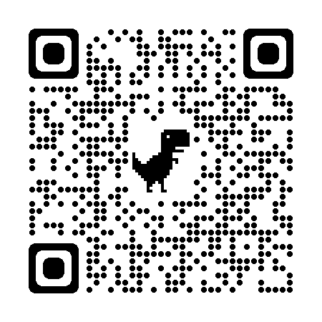
Club Apparel
We have a store available through Allstar Cresting
There are t-shirts, hoodies, outdoor jackets and more – Get in the spirit with quality merchandise. 10% goes to the club.
Here at the club, we also have mittens/gloves and a limited supply of skate guards for sale
Club competition/practice jackets are orderable through the club. Reach out to us at office@sherwoodparkdaleskatingclub.com if you are looking for an on-ice jacket. You can follow this link to our Allstar Store. This is also posted on our bulletin board.

Slide 18
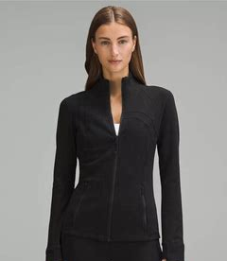
Team spirit
Club jackets are available to order. Your orders are Due by October 11th
Lululemon define jackets embroidered with the club logo and skaters Name or initials. Start at size 0
Great for both practice and competition
Youth sized are available by special order in a Lulu style jacket
Your cost: Lululemon $60 – 100 dependant on discount available: youth custom $45
The club pays the balance & the embroidery

Slide 19

Thank you

